Slide 1





Jupyter and TMVA
Attila Bagoly (Eötvös Loránd University, Hungary)
Mentors:
Sergei V. Gleyzer
Enric Tejedor Saavedra

Slide 2
Motivation
Jupyter notebook:
Portable: you just need a browser
Interactive coding
Document: HTML, Markdown support
Shareable: SWAN, nbviewer, binder
Integrating TMVA in Jupyter:
Support for TMVAGui in notebooks
Classifier visualizations
Pythonic interface for a bunch of functions
Interactivity: changes modify the state of TMVA
HTML formatted output

Slide 3
Code structure
Importing ROOT will import JsMVA, this will register jsmva magic
%jsmva on: JPyInterface inserts new methods to TMVA.DataLoader and TMVA.Factory, overloads some functions with a wrapper, register HTML transformer function
New methods: inserting HTML to cell output, with JavaScript call for JsMVA.js
JsMVA.js using JsROOT to create JavaScript plots

Slide 4
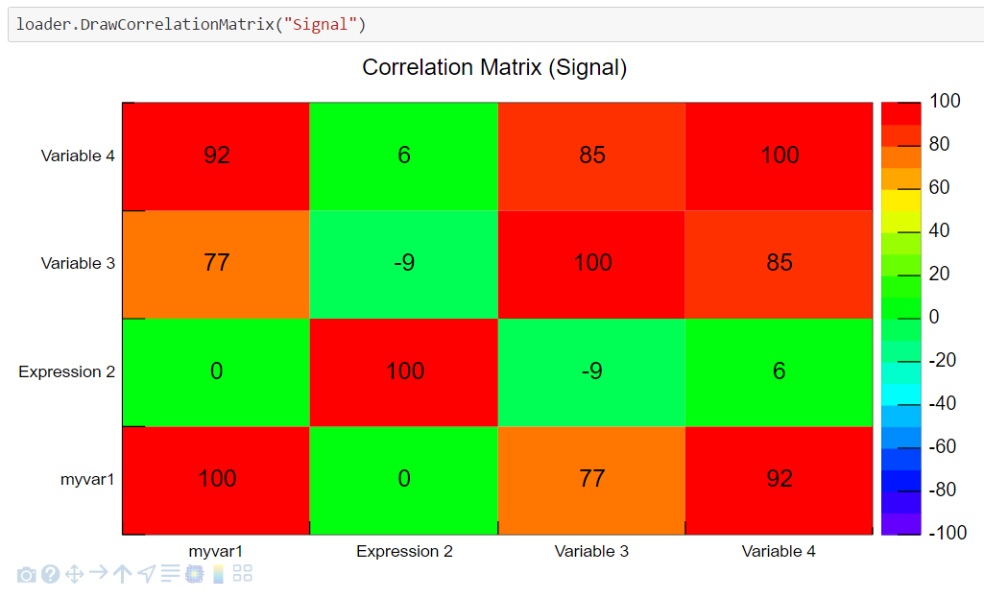
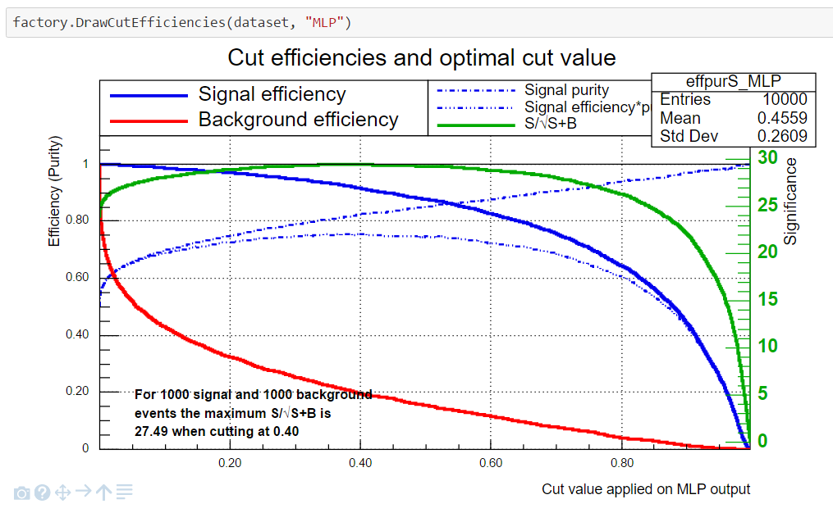
TMVAGui visualizations
Visualizations related to input variables
Correlation matrix
Input variables
Transform input variables & show
Visualizations related to classifier outputs
ROC curve
Output distributions
Cut efficiencies

Slide 5
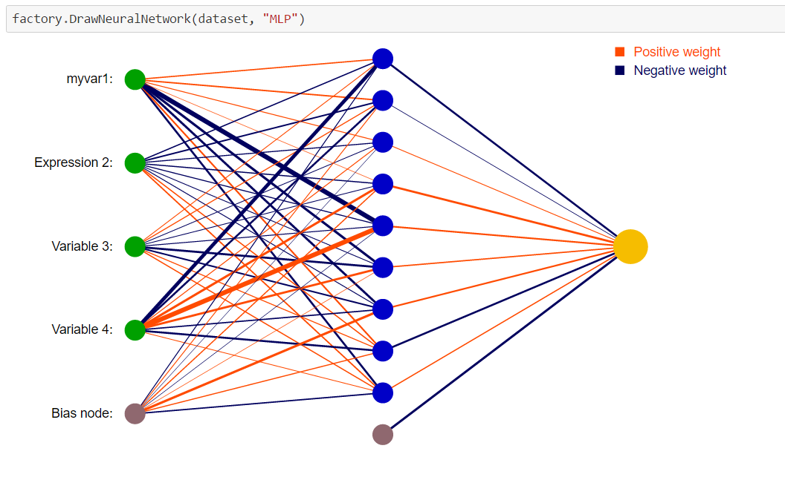
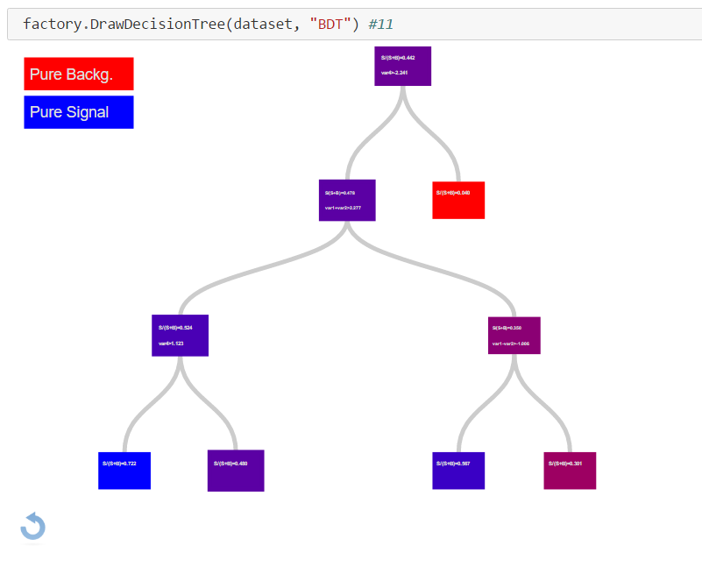
Classifier output: Neural networks, decision trees
Simple neural network
Deep neural network
Decision trees
Python function reads the network, converts to JSON; JS with d3js make the visualization from JSON
Interactive: focusing connections, zooming, moving
HTML5 Canvas visualization (speed)
Less interactive: zooming, moving
Ipywidgets: input field for selecting the tree
Visualization from JSON with D3js
Interactive: closing subtree, showing the path, focusing, moving, zooming, reset

Slide 6
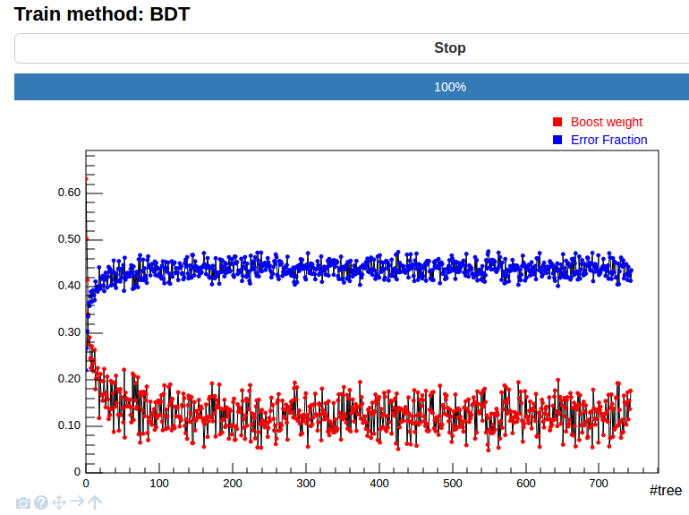
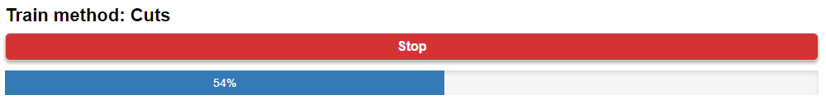
Interactive training mode
C++ interface for tracking/stopping the training
New thread for training
Main thread periodically refreshes the plot (inserts small JS script, which removes itself)
Error plots supported for MLP, DNN, BDT methods
Progress bar for a bunch of methods
Stop button: by clicking on it the main thread will send stop message for training loop (just the loop, no interfere with saving the net, or other data)

Slide 7
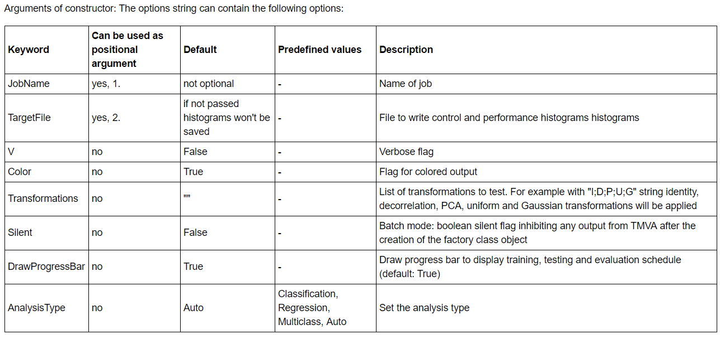
Pythonic user interface
New interface:
Bunch of functions use option string
Python: cleaner input without option strings
Wrapper functions for them, with jsmva magic these functions are replaced with corresponding wrapper function
The settings can be passed by named arguments: V=True,Transformations=[“I”,“D”] will be translated to “!V:Transformations=I,D”
Tutorial: http://nbviewer.jupyter.org/github/qati/GSOC16/blob/master/notebooks/ROOTbooks-TMVA-JsMVA-UserInterface.ipynb

Slide 8
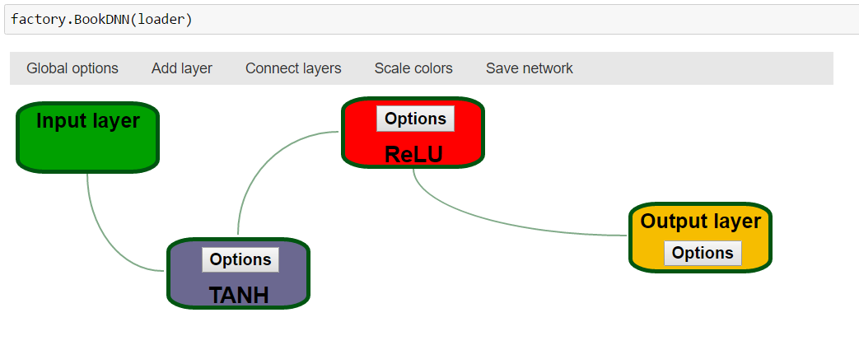
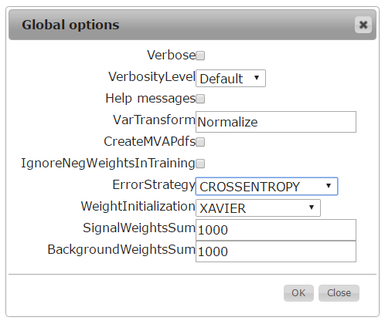
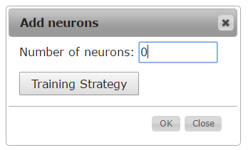
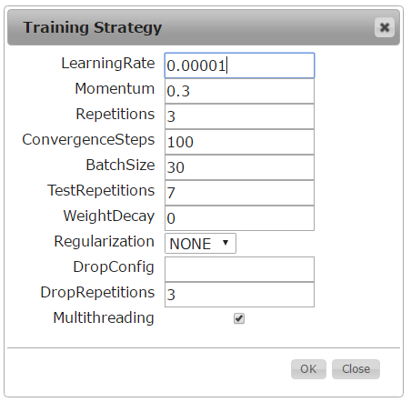
Deep neural network builder
Booking DNN: lot of settings, everybody forgets the exact names
Graphical interface: intuitive way to book DNN
We can add different types of layers
Specify the neuron number and training strategy for layer
Connect the layers: building the network
Save network: transform the graphical representation to option string and books the method

Slide 9
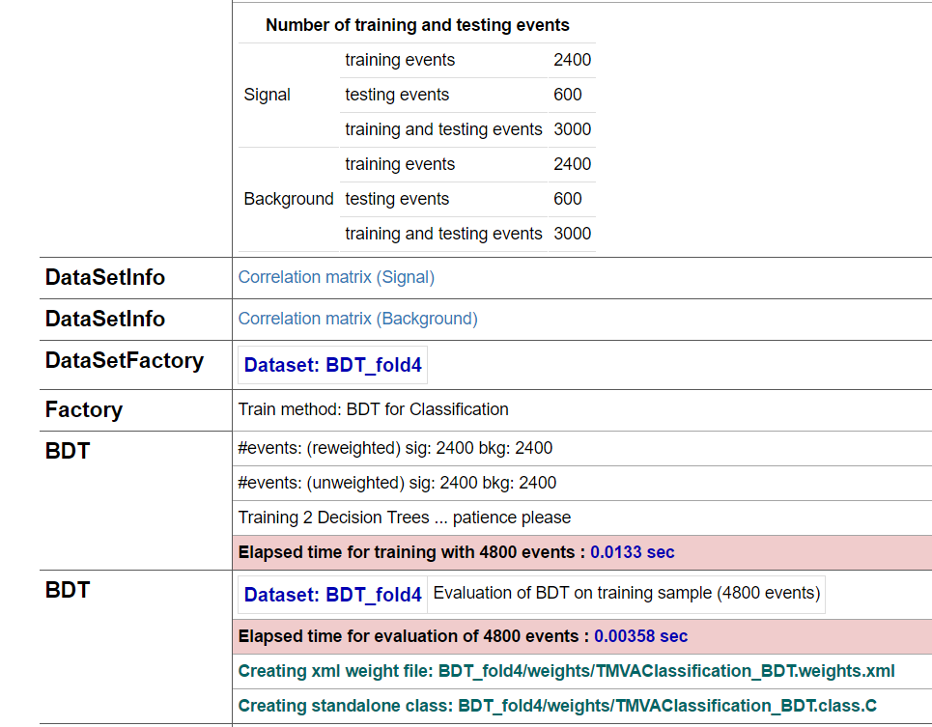
HTML formatted output
jsmva initialization register output transformer function to JupyROOT
also inserts CSS (for transformed output tables style) to notebook
The output transformer class:
Regular expressions for matching different output lines => logical units
Based on matchings the output is transformed to table structure (style: CSS)

Slide 10
Future of JsMVA
Visualizations for other classifiers
Improve interactive training (open closed notebook and continue training, new interactive plots)
Support for new user interface for new functions
Visualization for regression, multiclass classification, autoencoders
We are open to new suggestions

Slide 11
Summary
JsMVA can be activated easily, by using %jsmva on command
Visualizer methods inserted to TMVA::Factory, and TMVA::DataLoader
Implemented TMVAGui visualizations
Classifier visualizations: MLP, DNN, BDT
Interactive training mode: tracking the progress and the erros
New input mode (no more option strings), new output (HTML formatted)
DNN builder: graphical interface for booking DNN

Slide 12
List of new features
TMVAGui:
Classifier visualizations:
Interactive training mode
New user interface
HTML formatted output
Deep neural network builder
Input variable and transformed input visualization
Correlation matrix
Classifier output/probability distributions
Classifier cut efficiencies
Simple neural network
Deep neural network
Decision Tree

Slide 13
Notebooks
Everything on GitHub:
https://github.com/qati/GSOC16
Notebooks on nbviewer (static, rendered):
http://nbviewer.jupyter.org/github/qati/GSOC16/blob/master/index.ipynb
Notebooks on binder (interactive):
www.mybinder.org/repo/qati/GSOC16
Or you can download:
https://github.com/qati/GSOC16/tree/master/notebooks

Slide 14
Thank you for your attention!

